Slide 1
Visual C++
Lecture 1 – Introduction to C++ Programming

Slide 2
Outline
C++ using Visual Studio 2010
C++ Libraries
Program: Printing a Line of Text
Escape Sequences
Data Types
Program: Adding Two Integers
Arithmetic Operators
Equality and Relational Operators
Decision Making: if condition syntax + program

Slide 3
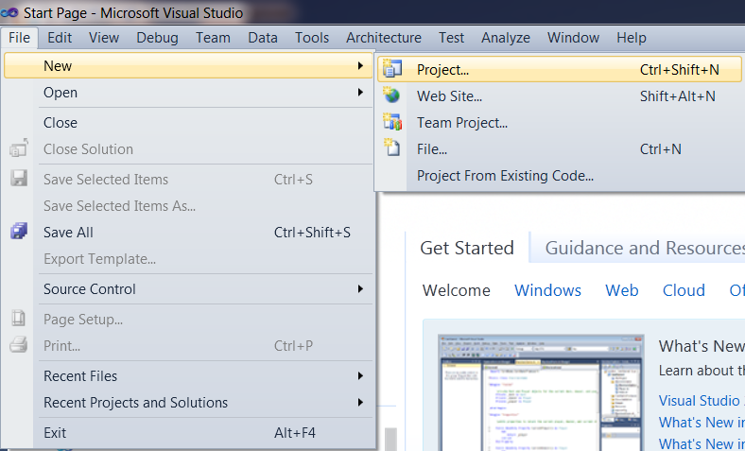
C++ using Visual Studio 2010: Step 1

Slide 4
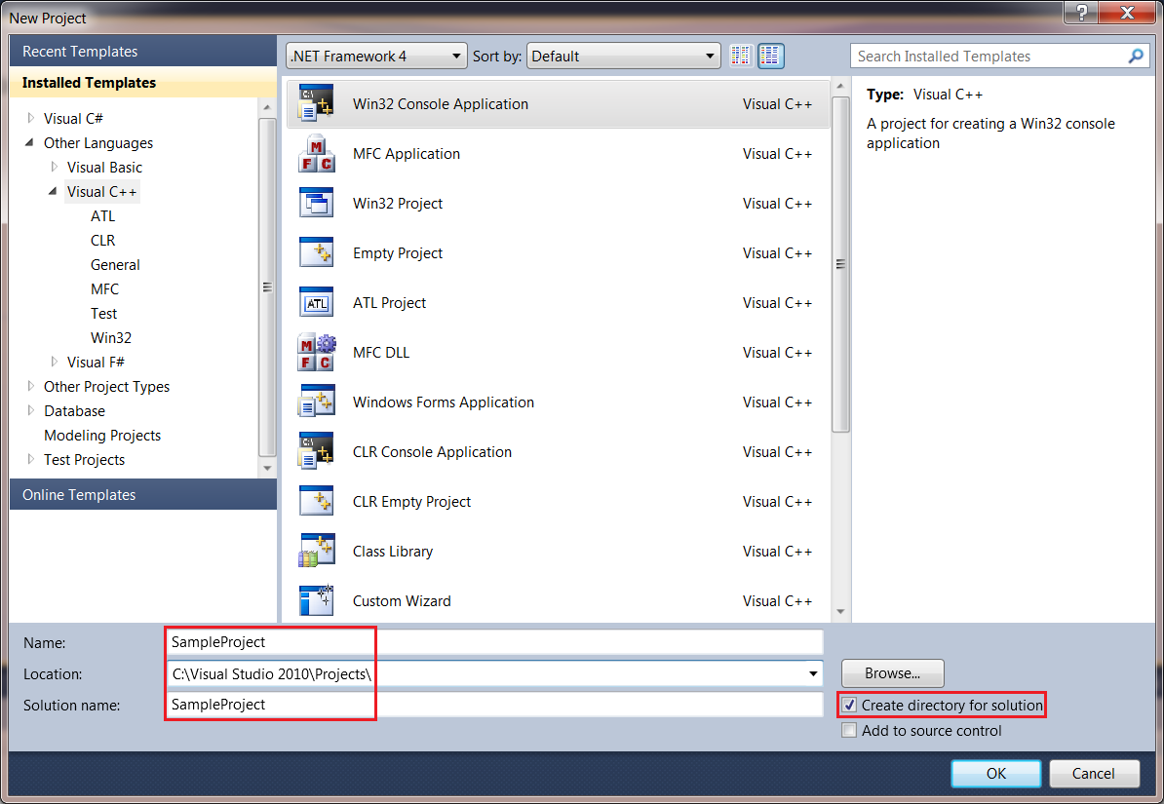
C++ using Visual Studio 2010: Step 2

Slide 5
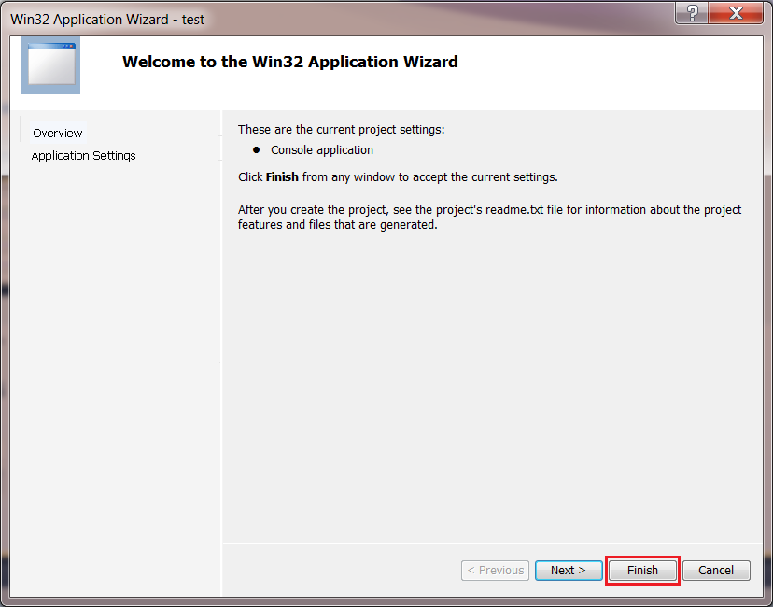
C++ using Visual Studio 2010: Step 3

Slide 6
C++ Libraries
Before writing any program, there are libraries that must be called. One of the libraries used in C++ is:
#include<iostream>
This library tells the preprocessor to include in the program the contents of the input/output stream header file <iostream>.
cout<< (output a stream of characters)
cin>> (input data to a variable)
This file must be included for any program that outputs data to the screen or inputs data from the keyboard.

Slide 7
Program: Printing a Line of Text

Slide 8
Escape Sequences
Escape Sequence | Description
\n | Newline
\t | Horizontal Tab
\r | Carriage Return
\a | Alert
\\ | Backslash
\” | Double Quote

Slide 9
Program: Printing a Line of Text (Continued)

Slide 10
Data Types
Data Type | Description
int | Integer Variables
double | Decimal Variables
float | Decimal Variables
char | Character Variables
bool | Boolean Variables (true or false)

Slide 11
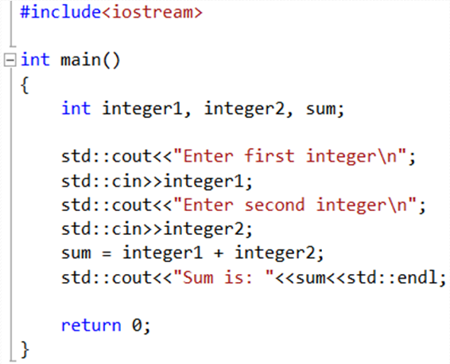
Program: Adding Two Integers

Slide 12
Arithmetic Operators
C++ Operation | Arithmetic Operator | C++ Expression
Addition | + | a + b
Subtraction | - | a – b
Multiplication | * | a * b
Division | / | a / b
Modulus | % | a % b

Slide 13
Equality and Relational Operators
Equality Operators | C++ Condition | Description
== | x == y | x is equal to y
!= | x != y | x is not equal to y
Relational Operators | C++ Condition | Description
> | x > y | x is greater than y
>= | x >= y | x is greater than or equal to y
< | x < y | x is less than y
<= | x <= y | x is less than or equal to y

Slide 14
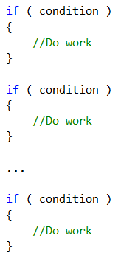
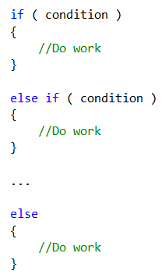
Decision Making: if condition syntax

Slide 15
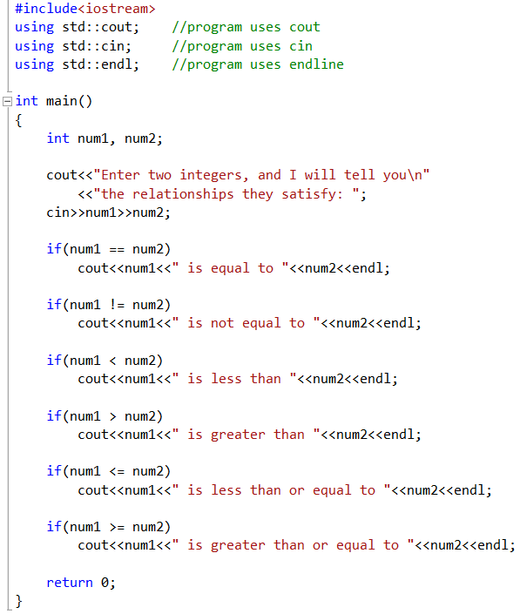
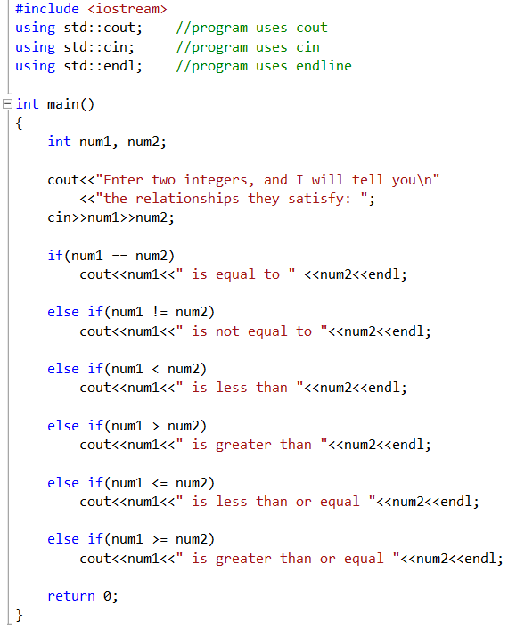
Program: Decision Making

Slide 16
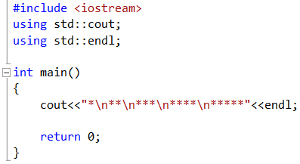
Exercise 1: What does the following code print ?

Slide 17
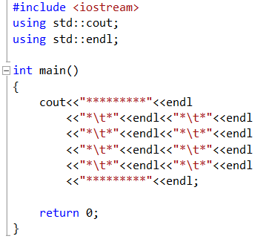
Exercise 2: What does the following code print ?

Slide 18
Exercise 3: Comparing Integers
Write a program that asks the user to enter two integers, obtains the numbers from the user, then prints the larger number followed by the words “is larger.” If the numbers are equal, print the message “These numbers are equal.”

Slide 19
Exercise 4: Odd or Even
Write a program that reads an integer and determines whether it’s odd or even.
[Hint: Use the modulus operator. An even number is a multiple of two. Any multiple of two leaves a remainder of zero when divided by 2].

Slide 20
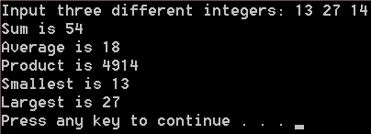
Exercise 5: Arithmetic, Smallest and Largest
Write a program that inputs three integers from the keyboard and prints the sum, average, product, smallest, and largest of these numbers. The screen dialog should appear as follows:

Slide 21
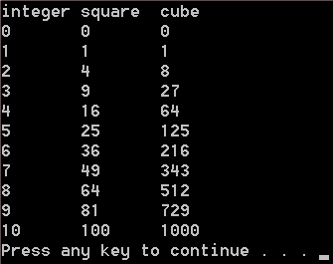
Exercise 6: Displaying a Table
Using the techniques of this chapter, write a program that calculates the squares and cubes of the integers 0 to 10. Use tabs to print the following formatted table of values:

Slide 22
Exercise 7: Digits of an Integer
Write a program that inputs a five-digit integer, separates the integer into its digits and prints them separated by three spaces each.
[Hint: Use the integer division and modulus operators.]
For example, if the user types in 42339, the program should print:

